Slide 1



F FORENSIC EXPERT ANDROID APPLICATION
Presented By
Navjot Singh( 11302225)
School Of Computer Application (SCA)
LOVELY PROFESSIONAL UNIVERSITY

Slide 2
Introduction and Objective
FES provides easy maintenance of all cases and users for Forensic Experts
Easy access to the records compare to manual system
FES will provide a set of forms to collect and capture evidences
Different module/form to capture each type of evidence
Synchronization of collected evidences to save on server
Generation of reports of each cases and their evidences

Slide 3

Why Android. ?
Google applications
widgets
Android Market
Java support
XML on Android
SQLite for databases

Slide 4

Features of App
Adding cases
Deleting cases
Updating case
Viewing case details
Creating new Users
Deleting users
Viewing users
Updating Information
My Account info
Change password activity
Sync with Web Services
Generating Reports for each case

Slide 5
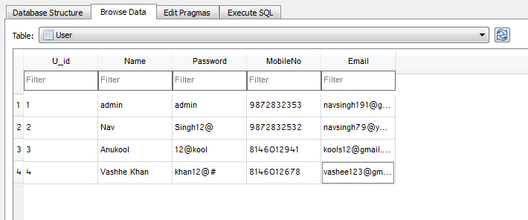
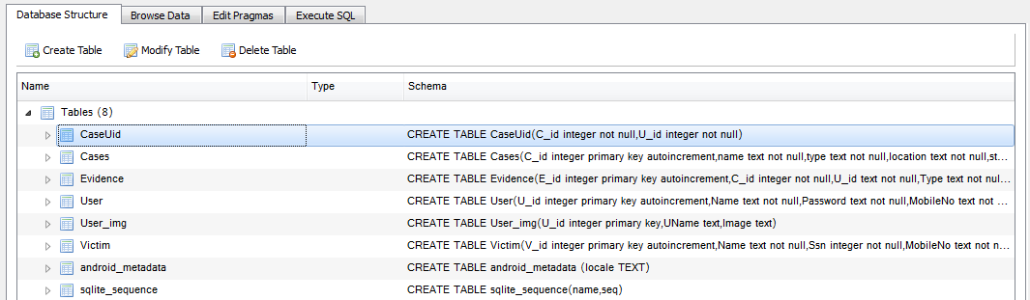
Table Desc:
db.execSQL("CREATE TABLE IF NOT EXISTS User(U_id integer primary key autoincrement,Name text not null,Password text not null,MobileNo text not null,Email text not null)");
db.execSQL("CREATE TABLE IF NOT EXISTS Victim(V_id integer primary key autoincrement,Name text not null,Ssn integer not null,MobileNo text not null,Email text not null)");
db.execSQL("CREATE TABLE IF NOT EXISTS Cases(C_id integer primary key autoincrement,name text not null,type text not null,location text not null,status text not null,start text not null,Addtime text not null,Des text not null)");
db.execSQL("CREATE TABLE IF NOT EXISTS Evidence(E_id integer primary key autoincrement,C_id integer not null,U_id text not null,Type text not null,Detail text not null,Image text ,time not null,date text not null)");
db.execSQL("CREATE TABLE IF NOT EXISTS User_img(U_id integer primary key,UName text,Image text)");
db.execSQL("CREATE TABLE IF NOT EXISTS CaseUid(C_id integer not null,U_id integer not null)");

Slide 6

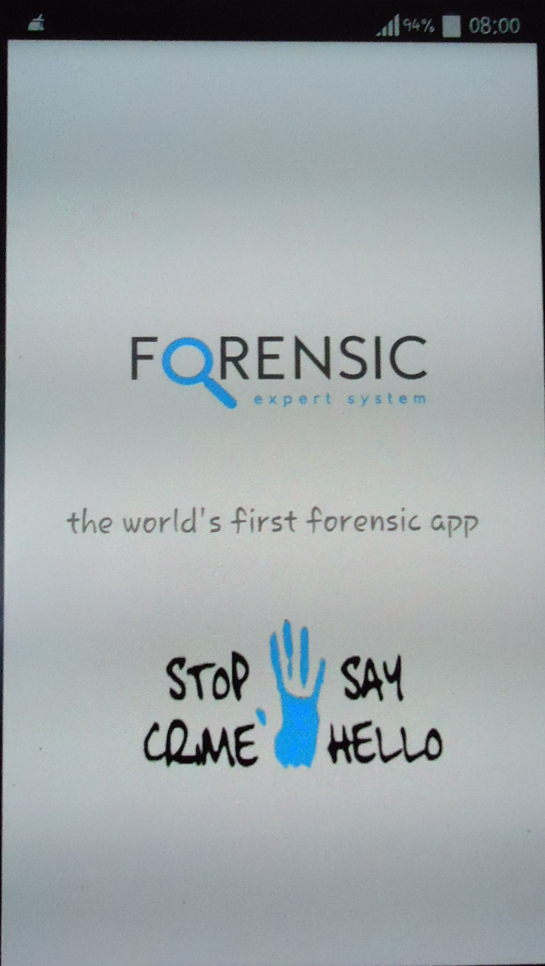
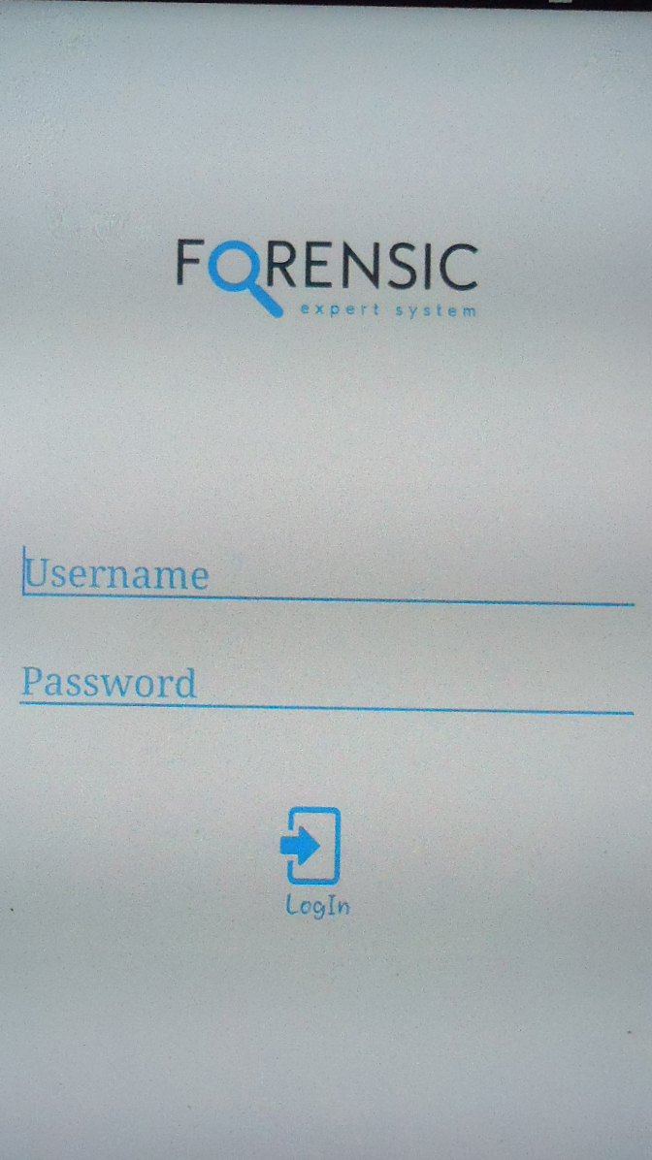
Forensic Expert Let’s Start it

Slide 7
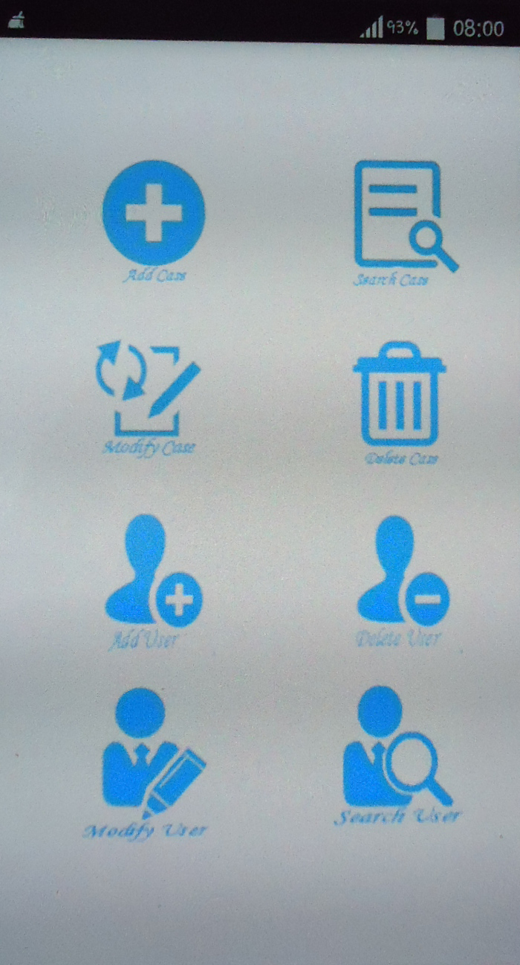
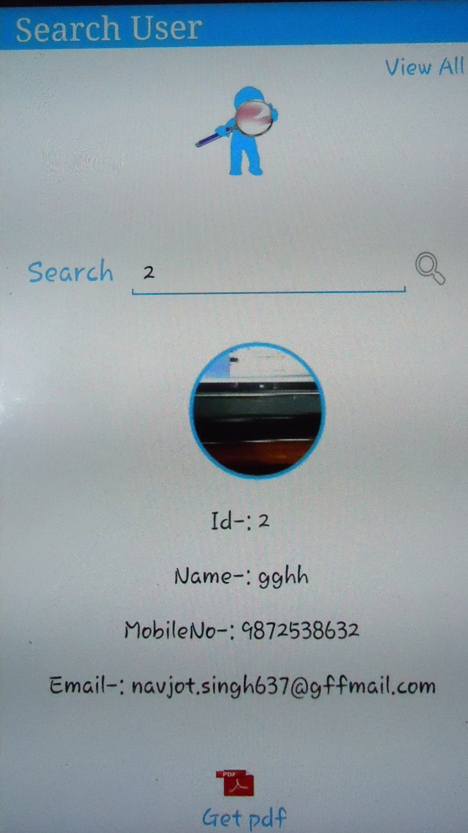
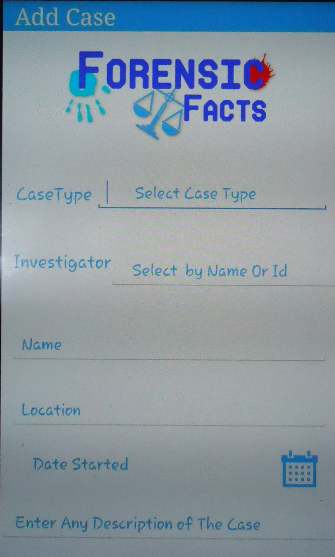
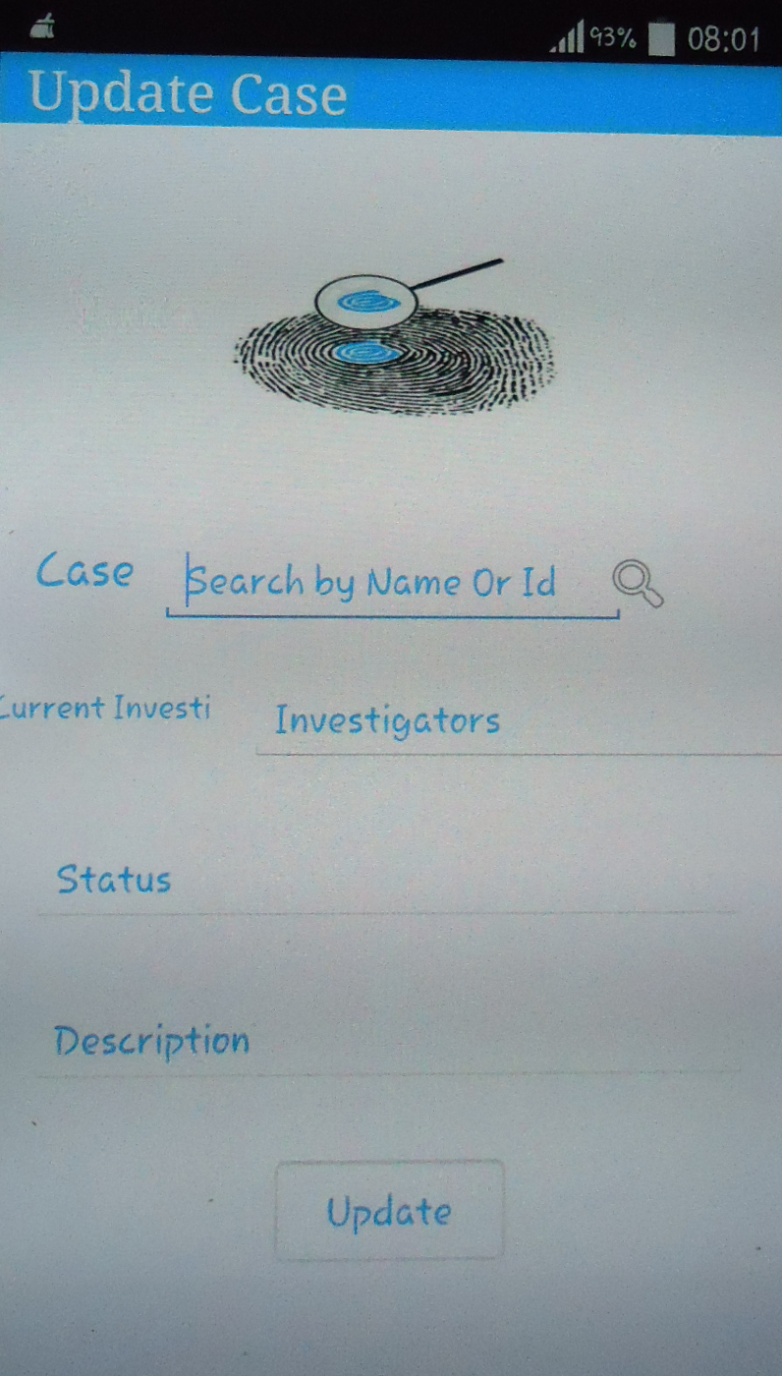
App Screen’s

Slide 8

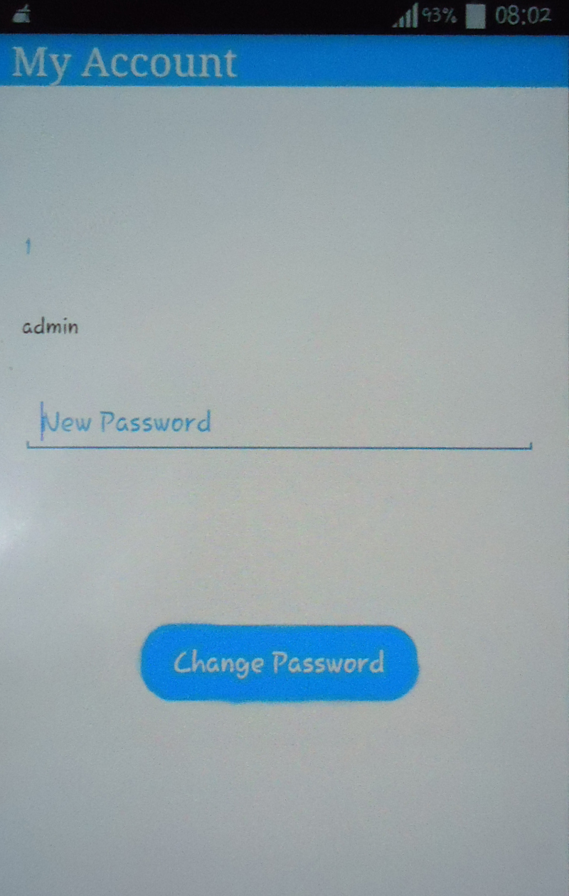
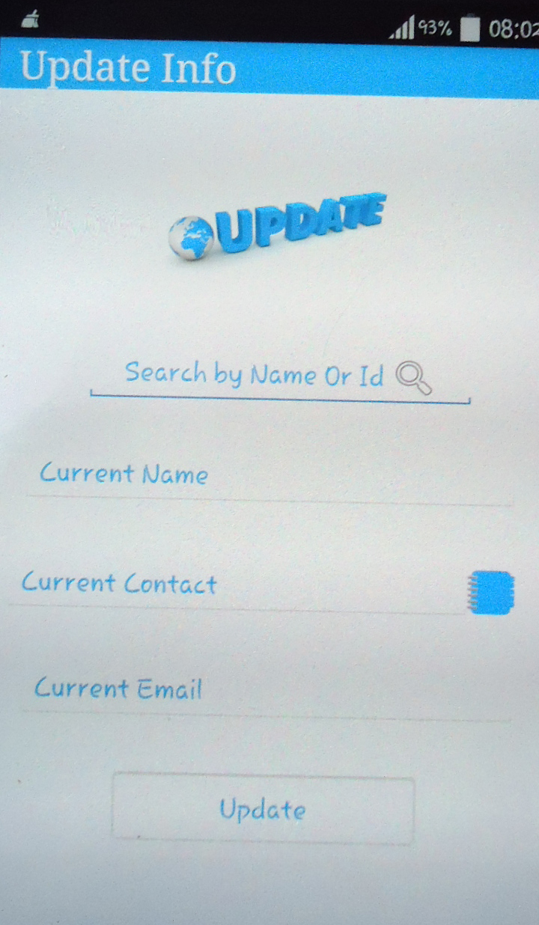
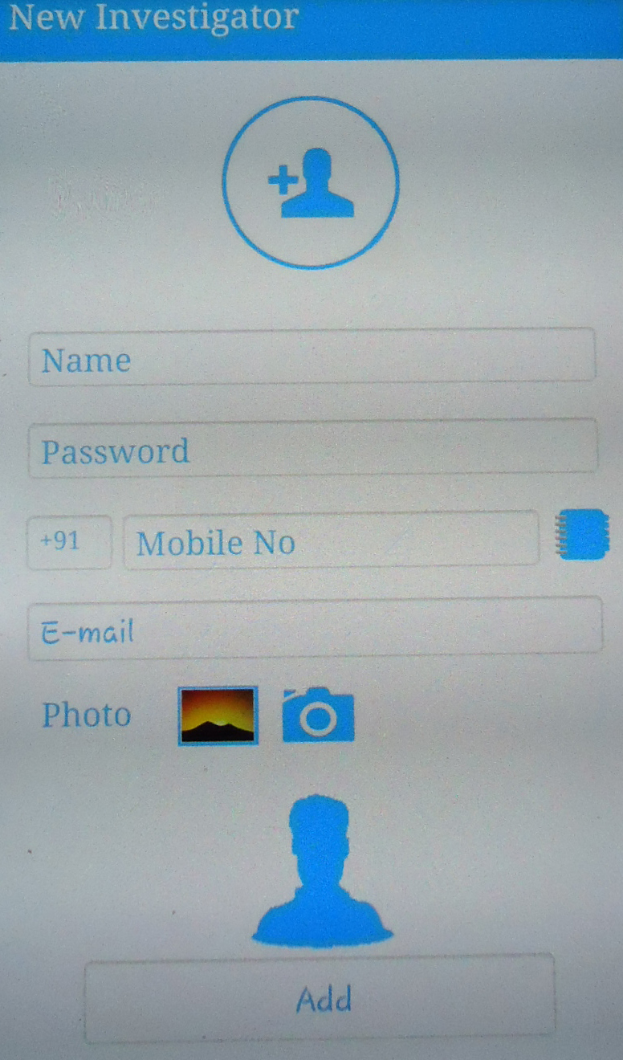
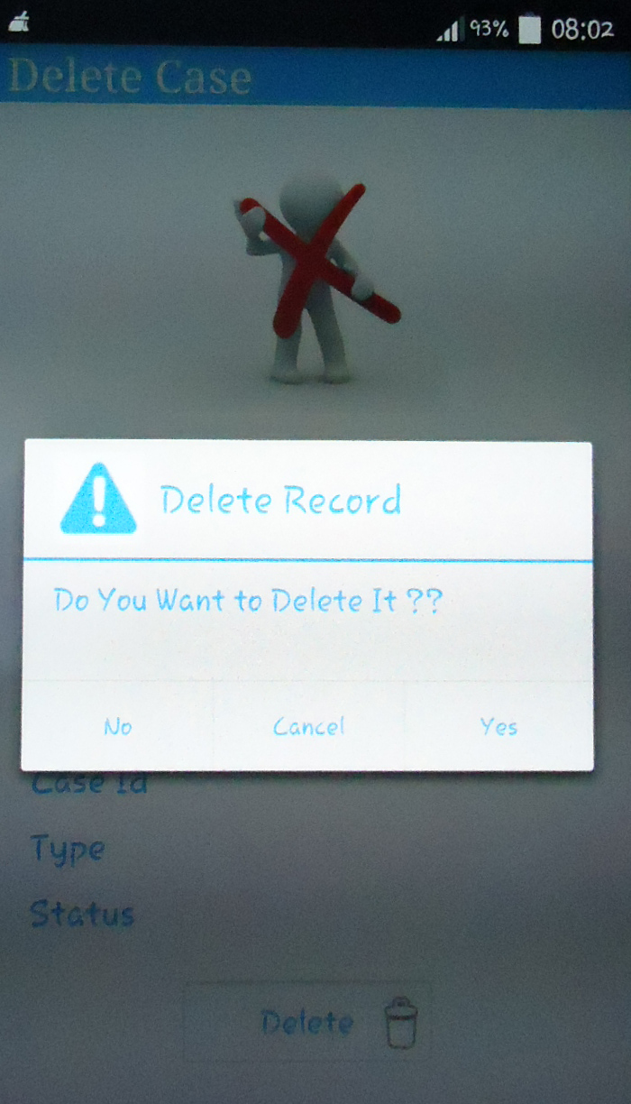
App Screen’s

Slide 9
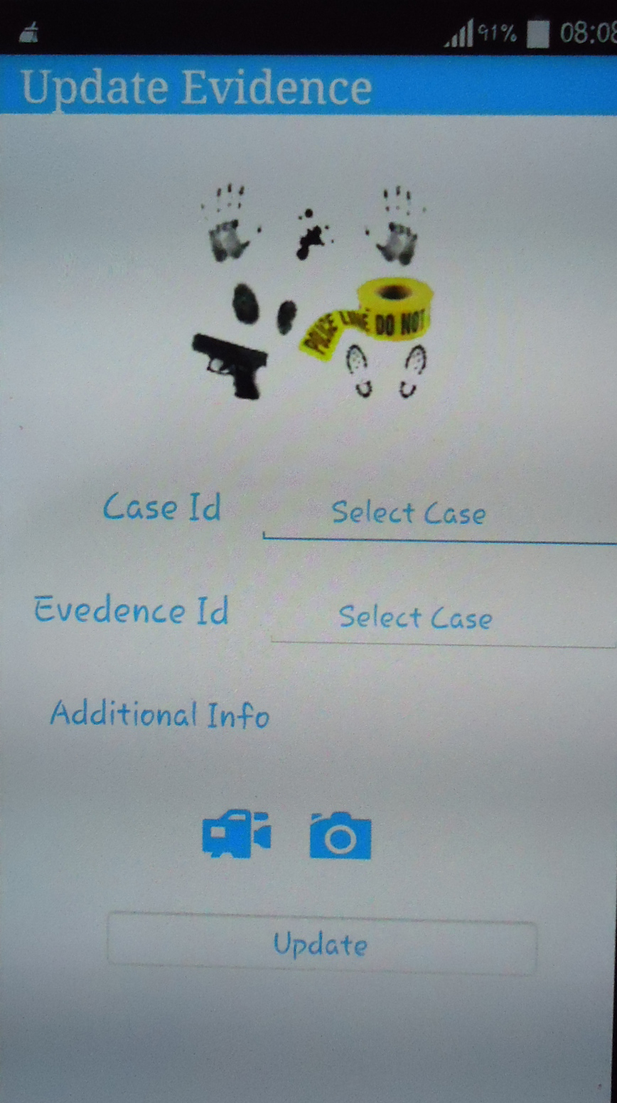
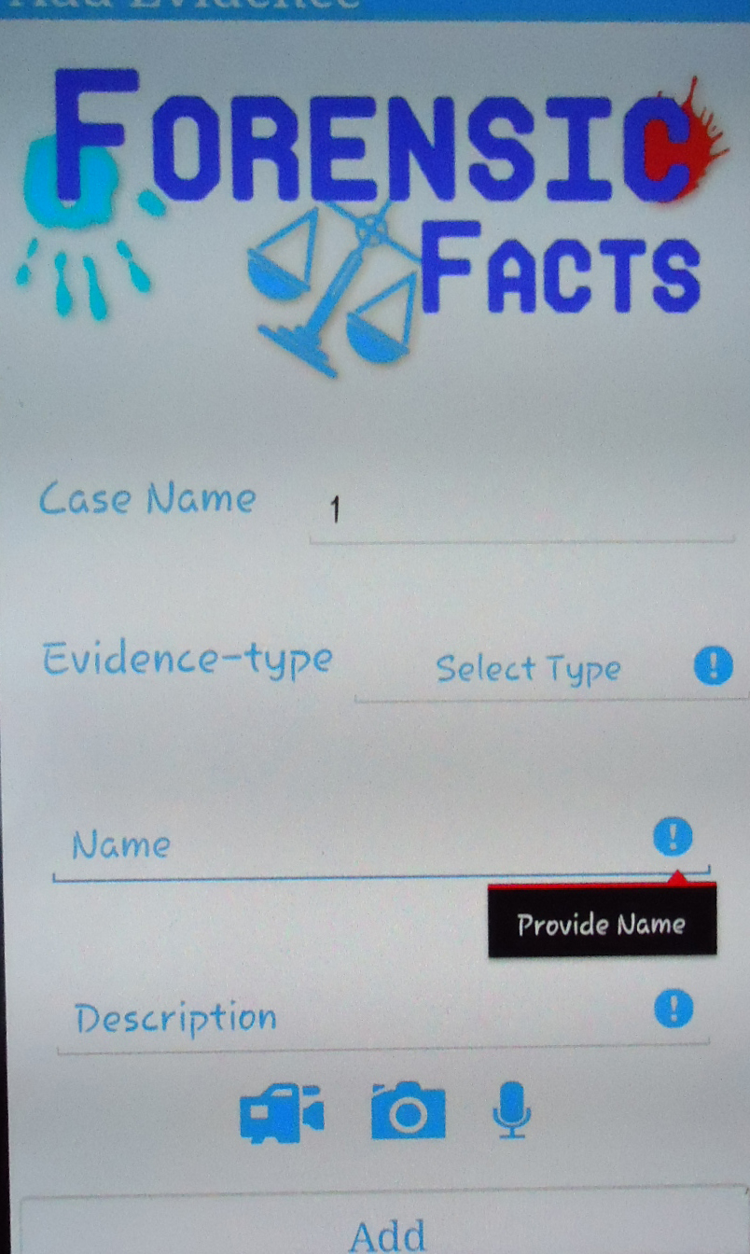
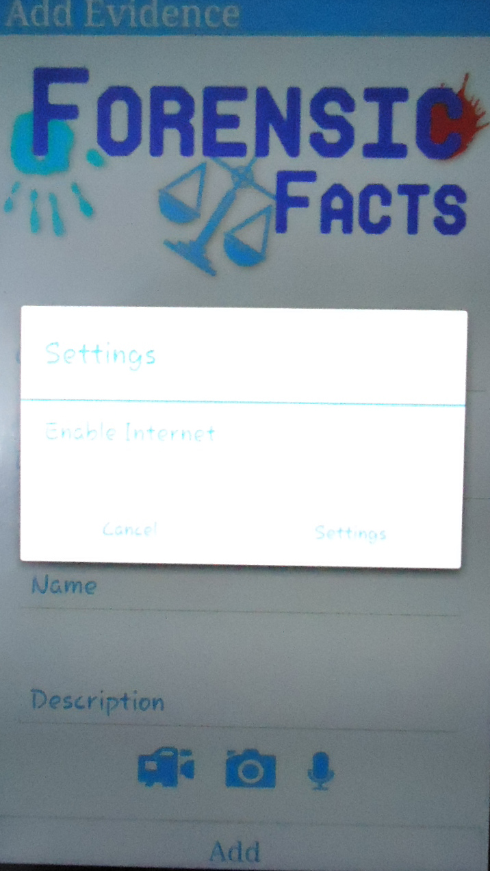
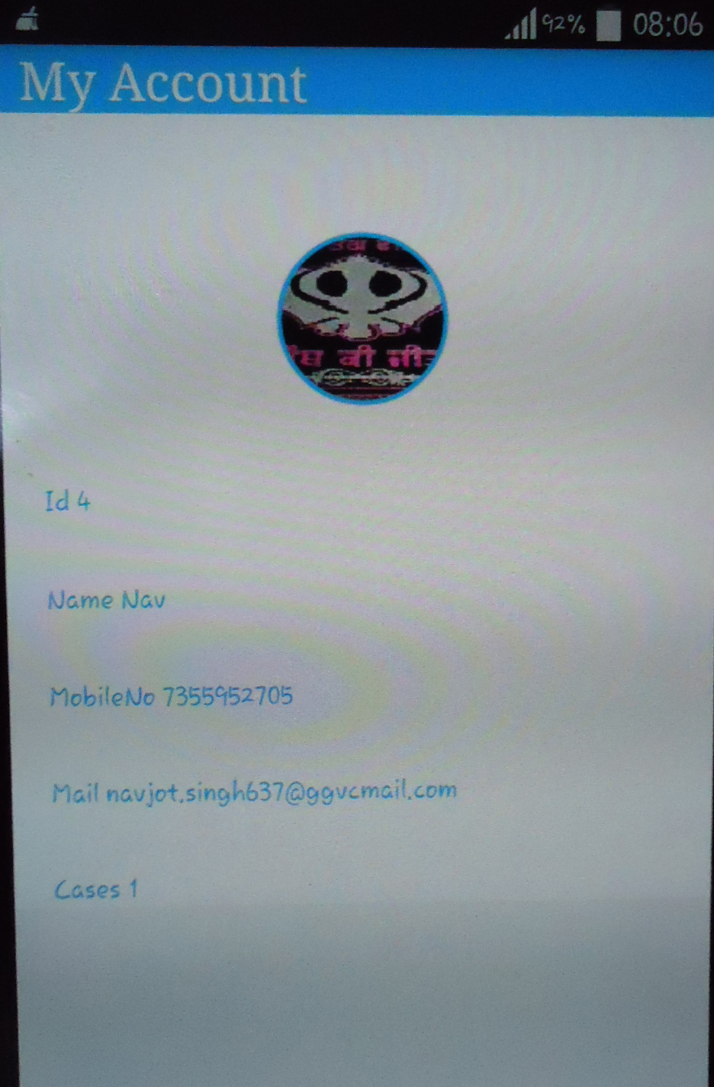
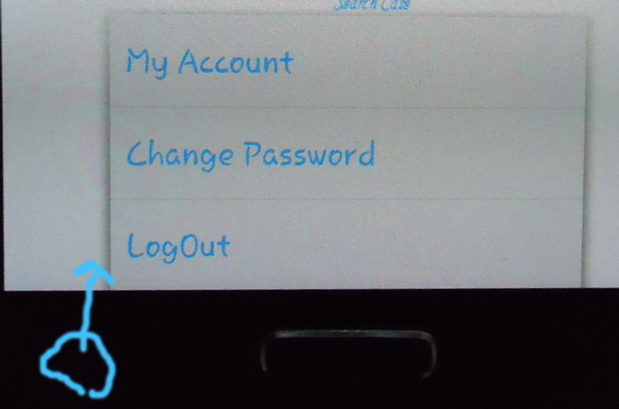
App Screen’s

Slide 10
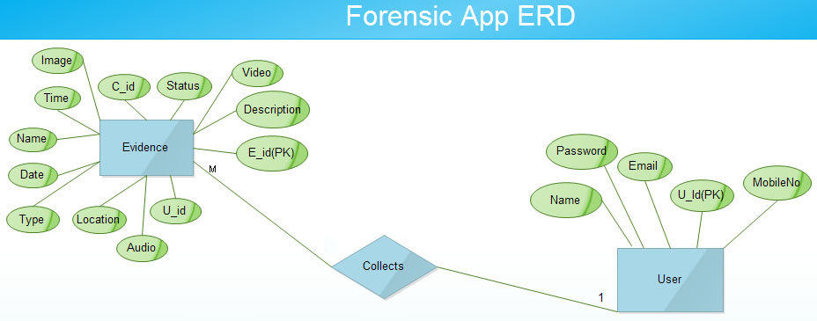
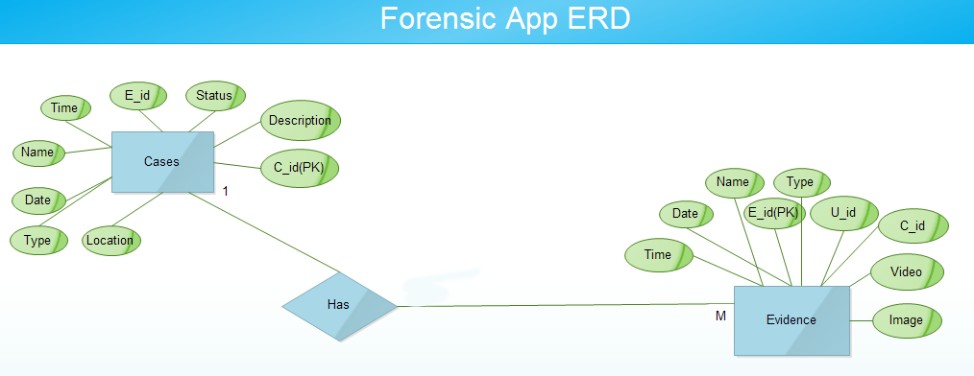
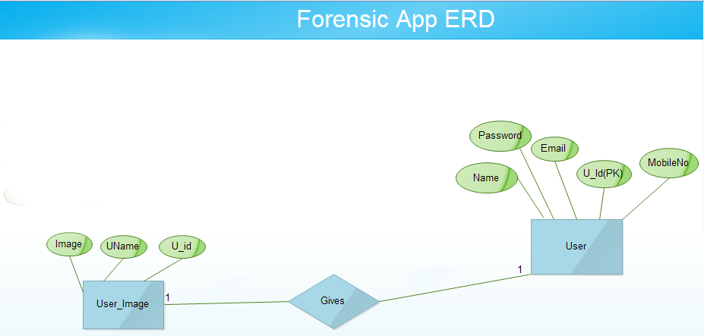
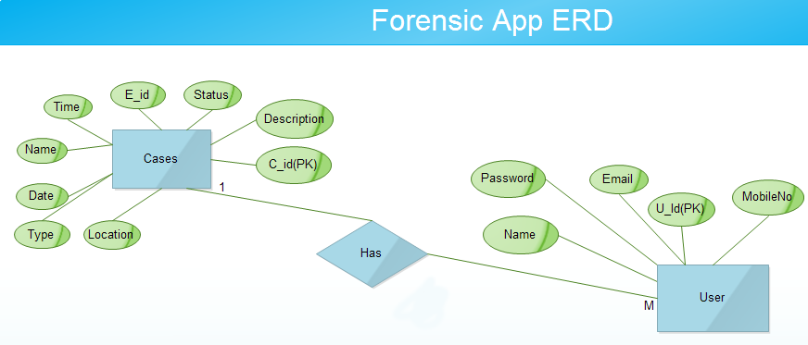
ER-Diagram

Slide 11
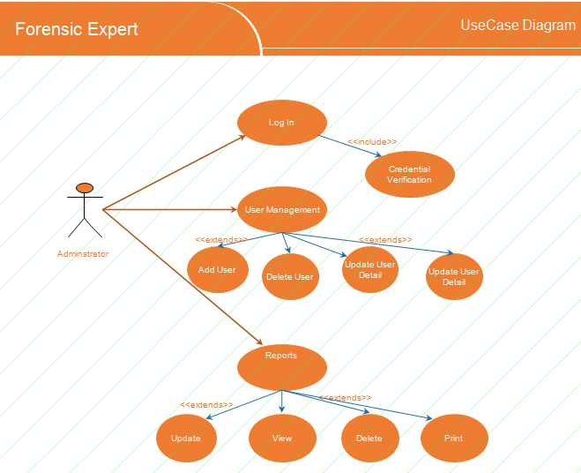
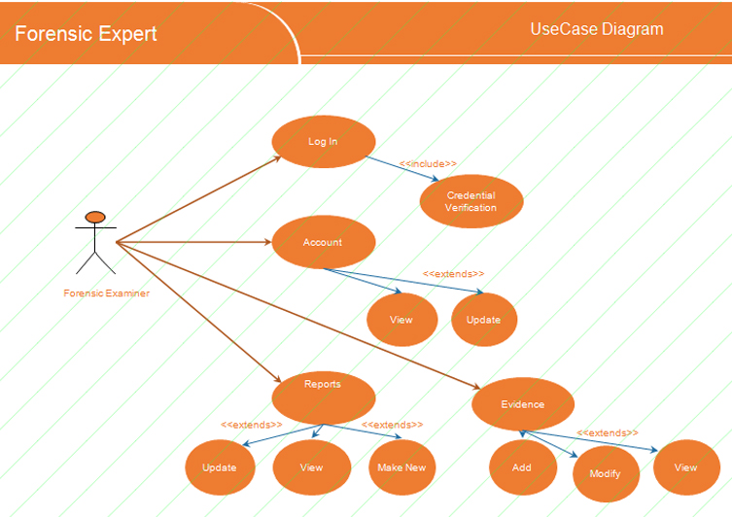
Use Case Diagram

Slide 12
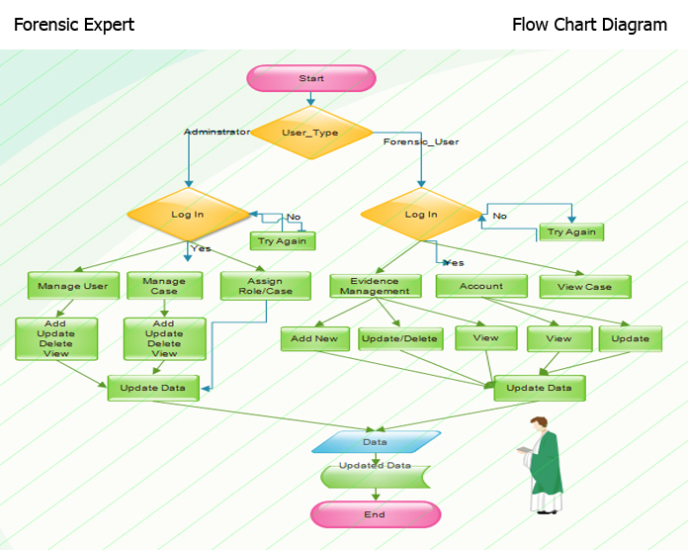
FLOW CHART

Slide 13
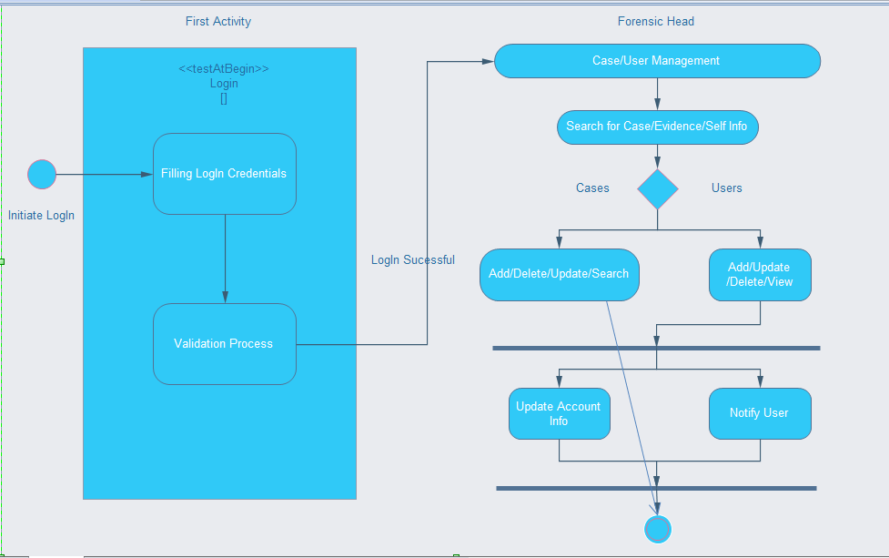
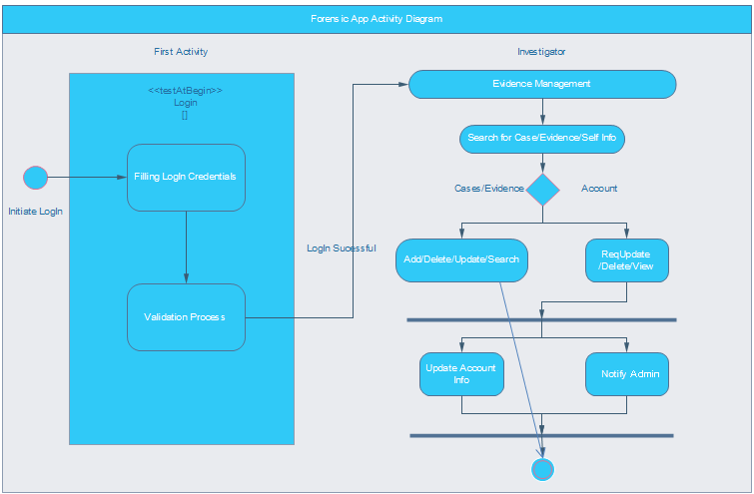
Activity Diagram

Slide 14
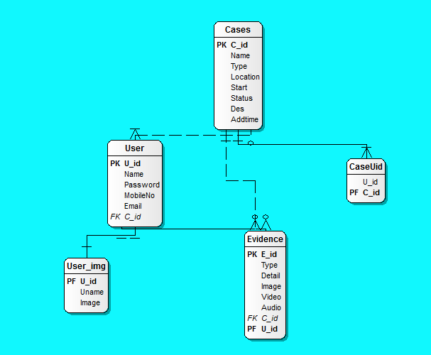
Relation Beteween Classes

Slide 15
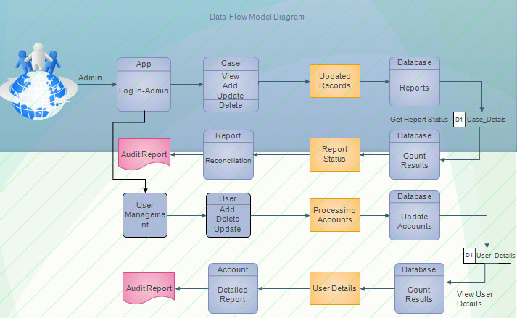
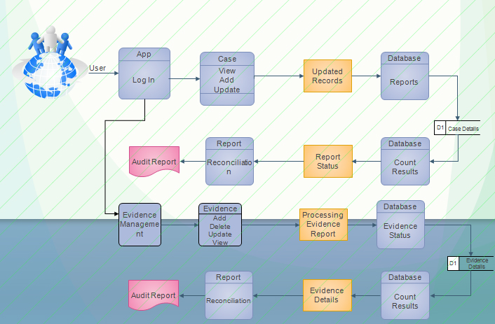
DATA FLOW DIAGRAM

Slide 16
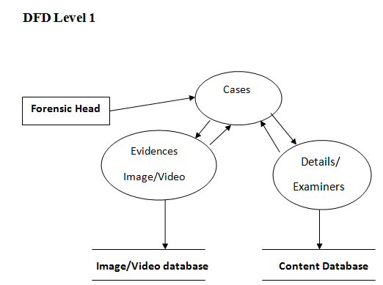
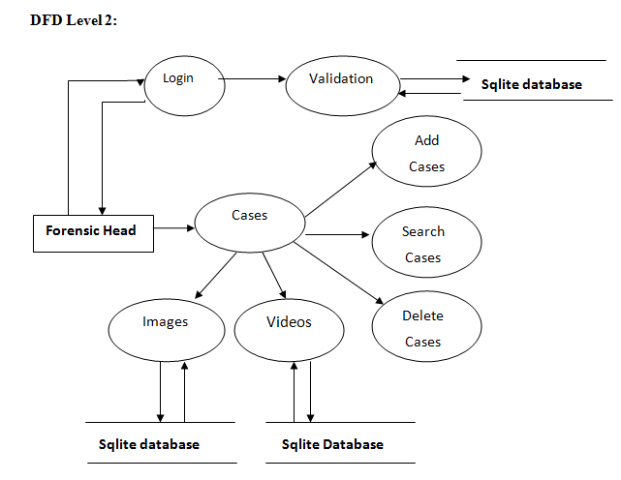
DATA FLOW DIAGRAM

Slide 17
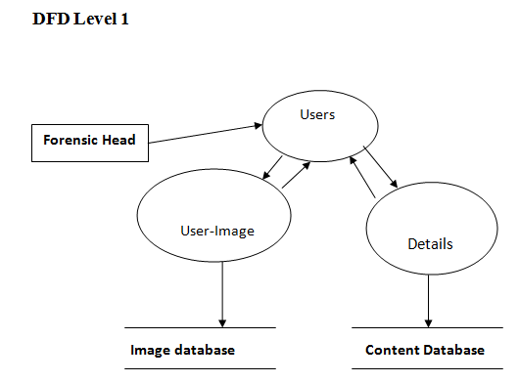
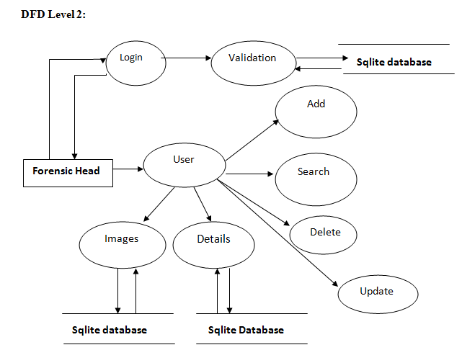
DATA FLOW DIAGRAM

Slide 18
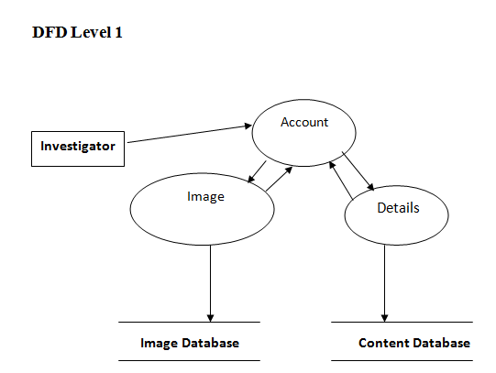
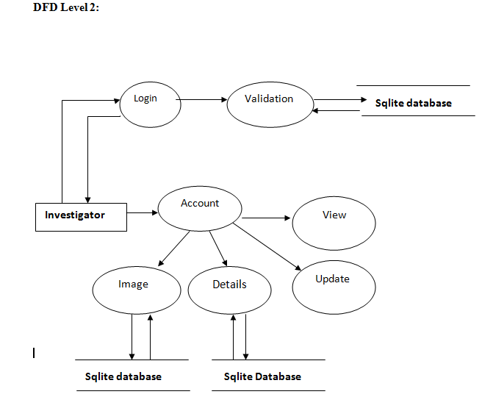
DATA FLOW DIAGRAM

Slide 19
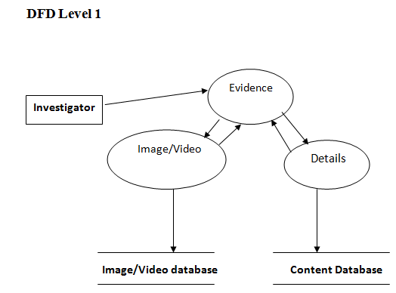
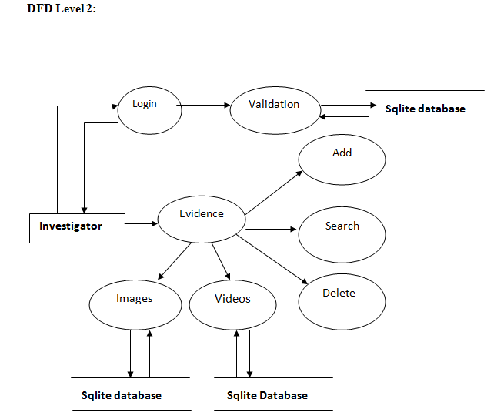
DATA FLOW DIAGRAM

Slide 20
Demo Time!
Application Demo on Android Phone.

Slide 21
Thank You For your time.
Questions and Suggestions Welcomed.

